Slide 1
WEEK 2 - Tablet Team
Cameron, Sam, Lio, Ray, Diogo and Jose

Slide 2
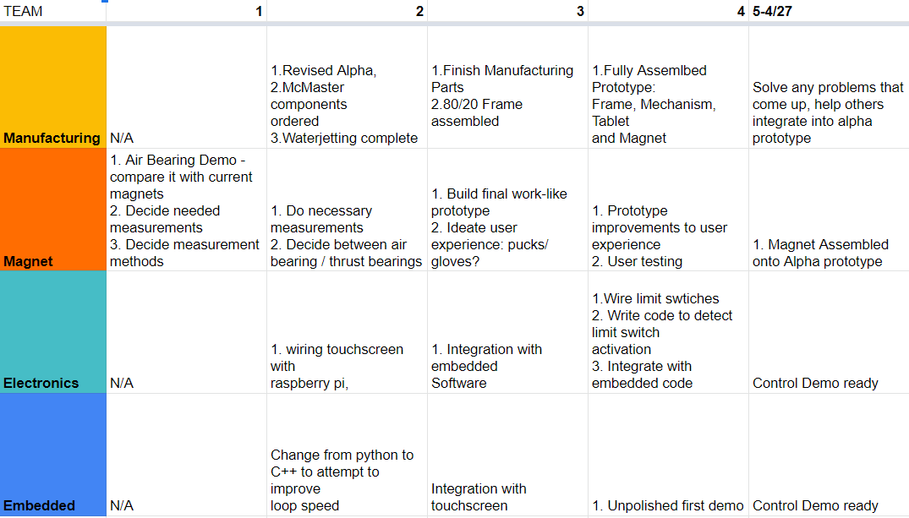
Alpha Timeline

Slide 3
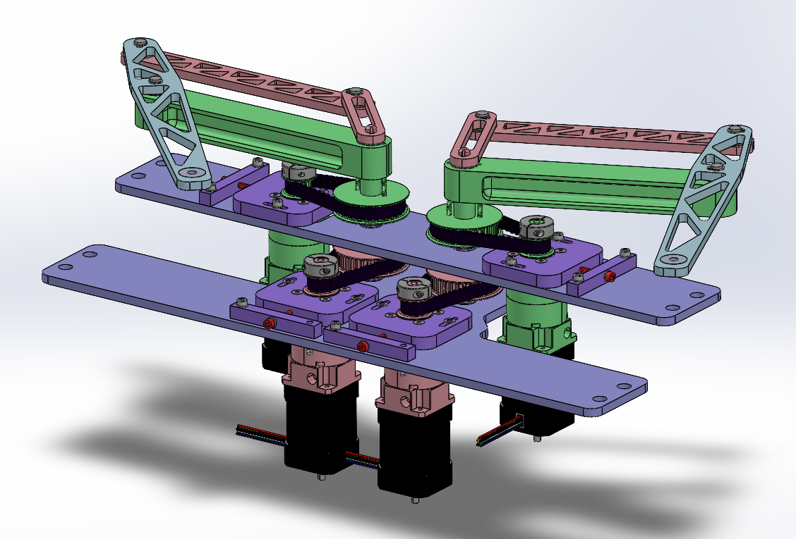
Manufacturing - Cam & Sam
Progress
Revised transmission design
Ordered parts and stock
Problems
Asymmetric keyway
Preview
Water jetting and beginning post-processing

Slide 4
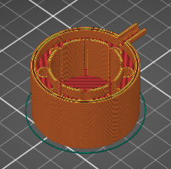
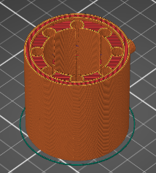
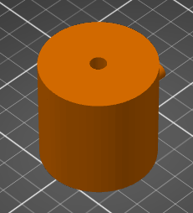
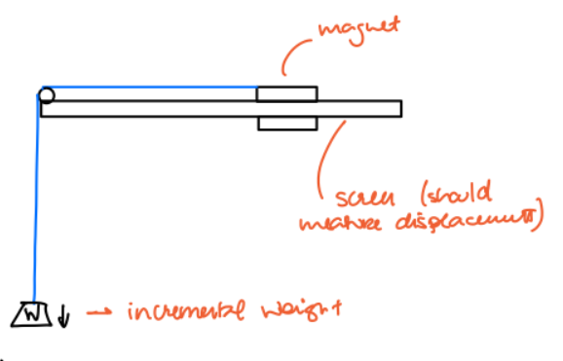
Magnet - Diogo & Jose
New air bearing design
Continue with thrust bearings
Plans for measuring lateral forces

Slide 5
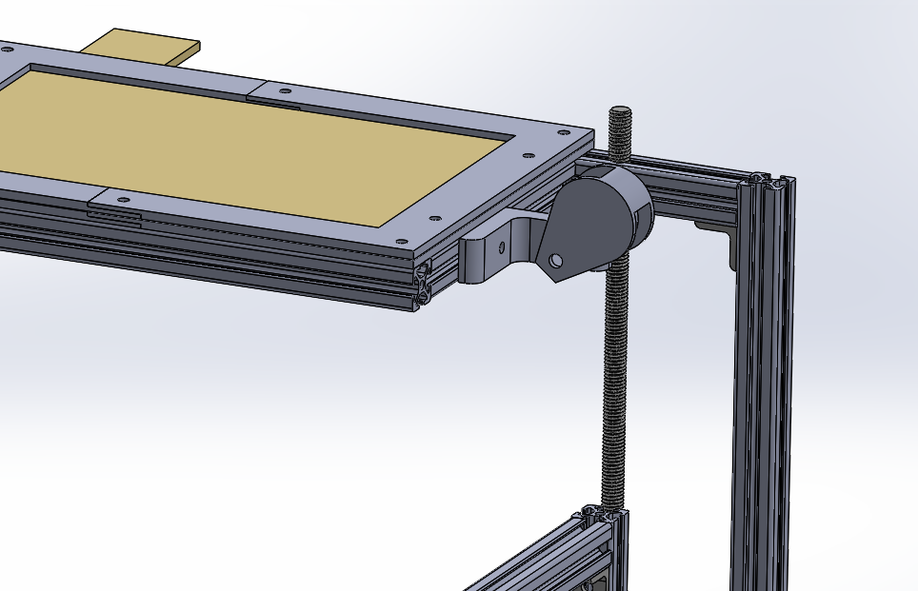
Magnet - Diogo & Jose
Get set of weights and measure:
Max shear force
Min free motion force
Magnet has to touch the screen?
Need to experiment more

Slide 6
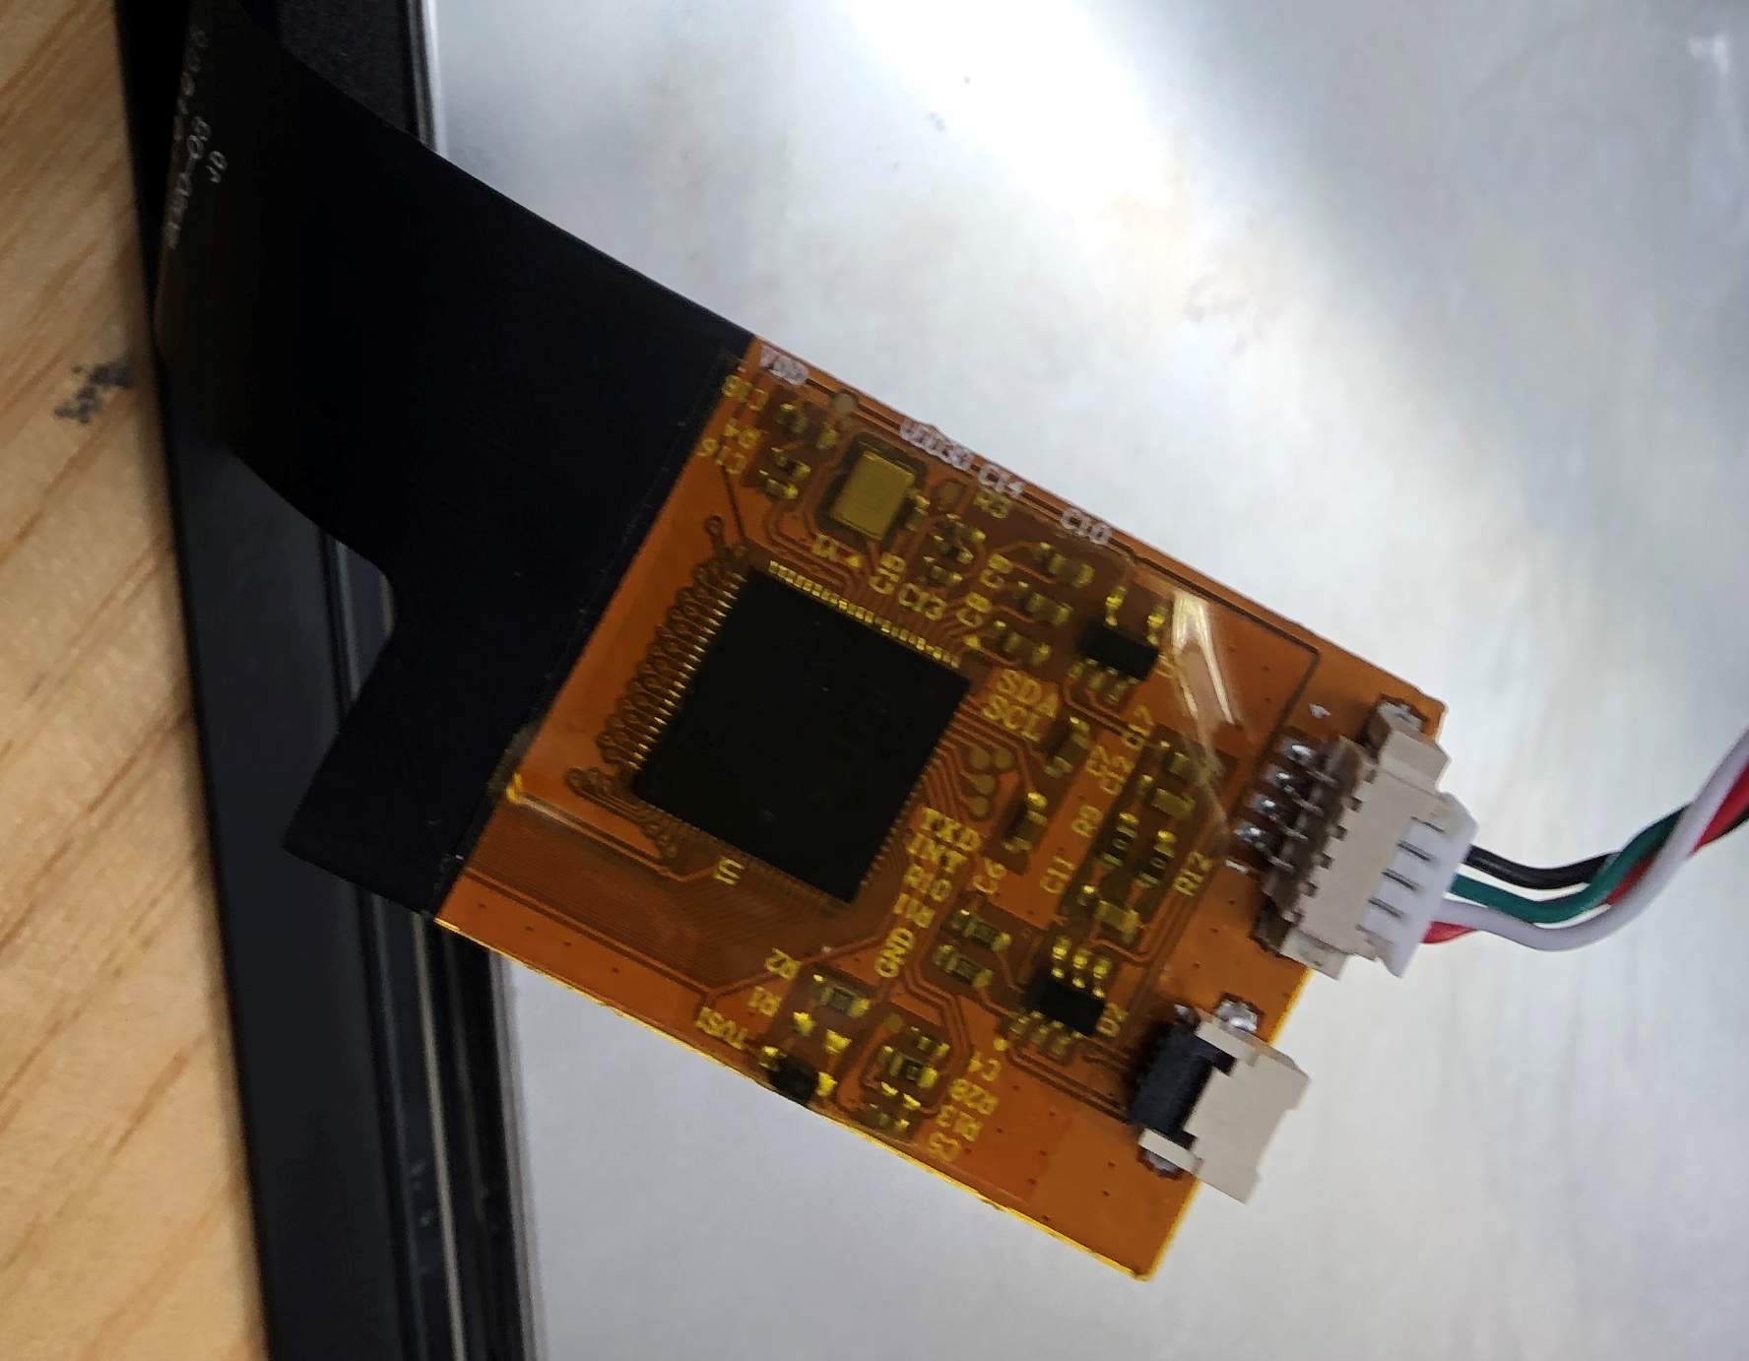
Electronics - Ray
- Magnet cannot drive the conductive touchscreen, we might combine conductive foam with the magnet. However, it will increase the friction.
- The four pin of the touchscreen sensor are 5V, SDA, SCL, and GND.

Slide 7
Embedded - Lio Frequency test
Baud rate 2304000
One cycle contains:
Request position and vel(unit in revolution) for shoulder and elbow joint
Receive data and preprocess(offset elimination and reduction ratio calculation) to get actual angle.
Calculate position in 2D tablet and Jacobian
Determine the force act on end-effect and trans to torque with Jacobian
Send cmd to Odrive
Test result
Request: “f 0/n” 20 μs
Wait for response 100 - 200 μs
Calculation TBD
Send cmd to Odrive 50 μs
1000hz need Calculation in 700 μs
2000hz need Calculation in 200 μs
All is in single motor but we need to do 4 motors in one time

Slide 8
Embedded - Lio Frequency test
We need to do 4 motors in one time
Solution:
Take advantage of 2 odrive we have:
Odrive_1 connect 2 shoulder joint
Odrive_2 connect 2 elbow joint
Sync request left arm(or right arm)shoulder & elbow joint pos
Send back cmd to Odrive_1 & Odrive_2 at same time
Alternately control the left and right arms
Total frec 1000HZ
Microcontroller
Arm1 Shoulder Arm1 Elbow Calculation & Cmd Arm 1
Arm2 Shoulder Arm2 Elbow Calculation & Cmd Arm 2
Odrive_1
Odrive_2

Slide 9
Embedded - Lio Calibration
We need four switch add in our mech design to help us do the calibration every time we startup. Because we use the incremental encoder.
Touch screen calibration TBD.

